Slide 1
WOMEN’S EDUCATION FROM ANCIENT TO MODERN AGE 3rd SEMESTER/PAPER-303
BY:-
Mrs.RINKI KUMARI
DEPTT.OF EDUCATION
MMHA&PU, PATNA
DATE:-13th august,2020

Slide 5
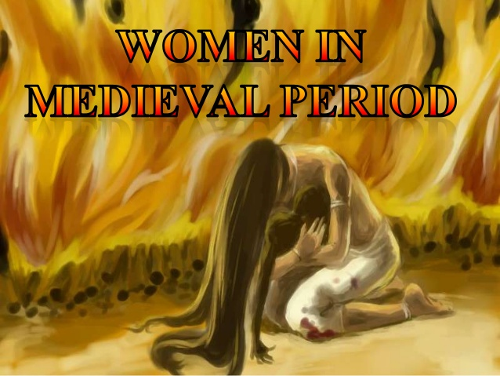

Slide 7
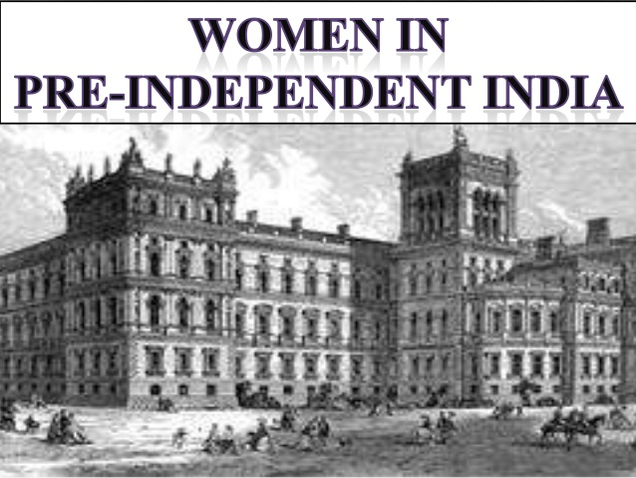

Slide 9
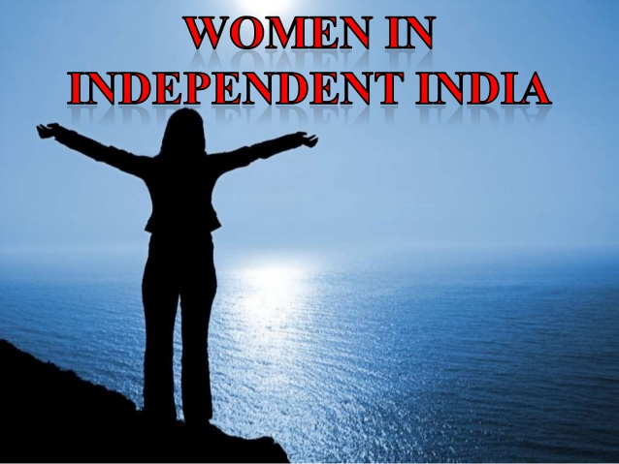

Slide 10
